Slide 1
Unit-1: Entity-Relationship Model
Entity Sets
Relationship Sets
Design Issues
Mapping Constraints
Keys
E-R Diagram
Extended E-R Features
Design of an E-R Database Schema
Reduction of an E-R Schema to Tables

Slide 2
Entity Sets
A database can be modeled as:
a collection of entities,
relationship among entities.
An entity is an object that exists and is distinguishable from other objects.
Example: specific person, company, event, plant
Entities have attributes
Example: people have names and addresses
An entity set is a set of entities of the same type that share the same properties.
Example: set of all persons, companies, trees, holidays

Slide 3
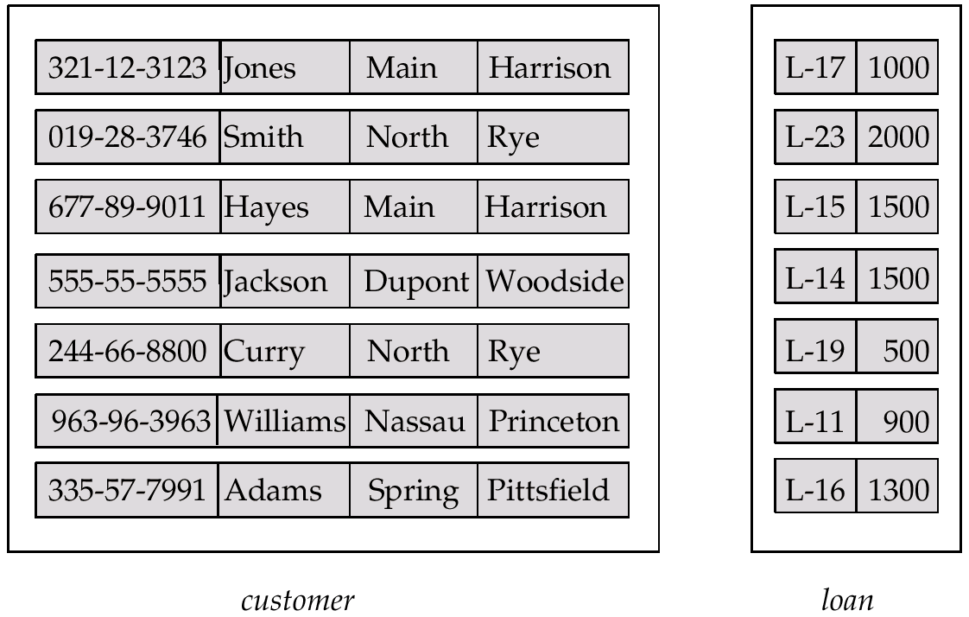
Entity Sets customer and loan
customer-id customer- customer- customer- loan- amount name street city number

Slide 4
Attributes
An entity is represented by a set of attributes, that is descriptive properties possessed by all members of an entity set.
Domain – the set of permitted values for each attribute
Attribute types:
Simple and composite attributes.
Single-valued and multi-valued attributes
E.g. multivalued attribute: phone-numbers
Derived attributes
Can be computed from other attributes
E.g. age, given date of birth
Example:
customer = (customer-id, customer-name, customer-street, customer-city) loan = (loan-number, amount)

Slide 5
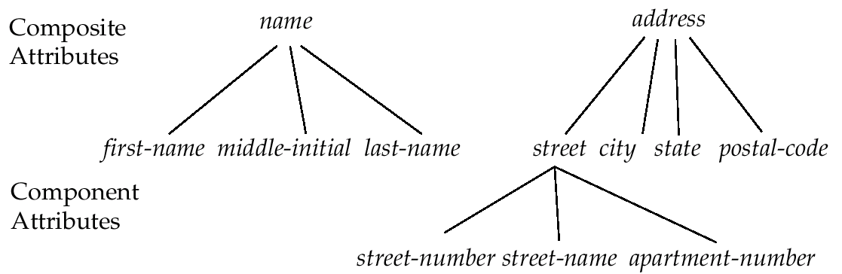
Composite Attributes

Slide 6
Relationship Sets
A relationship is an association among several entities
Example: Hayes depositor A-102 customer entity relationship set account entity
A relationship set is a mathematical relation among n ≥ 2 entities, each taken from entity sets
{(e₁, e₂, … e_{n}) | e₁ ∈ E₁, e₂ ∈ E₂, …, e_{n} ∈ E_{n}} where (e₁, e₂, …, e_{n}) is a relationship
Example:
(Hayes, A-102) ∈ depositor

Slide 7
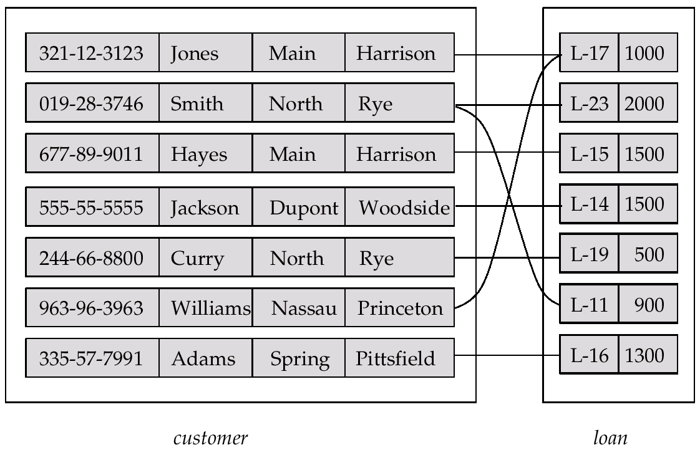
Relationship Set borrower

Slide 8
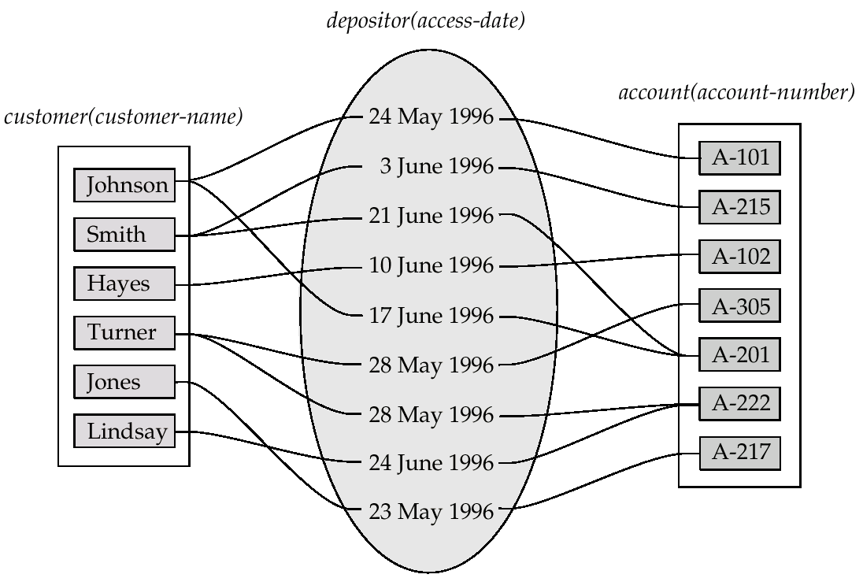
Relationship Sets (Cont.)
An attribute can also be property of a relationship set.
For instance, the depositor relationship set between entity sets customer and account may have the attribute access-date

Slide 9
Constraints
Constraints enforce limits to the data or type of data that can be inserted/updated/deleted from a table.
The whole purpose of constraints is to maintain the data integrity during an update/delete/insert into a table.
Mapping Cardinalities(Mapping constraints)
Key Constraints
Domain integrity constraints & Referential Integrity constraints
Participation Constraints
We can have these constraints in place while creating tables in database.

Slide 10
Mapping Cardinalities
Express the number of entities to which another entity can be associated via a relationship set.
Most useful in describing binary relationship sets.
For a binary relationship set the mapping cardinality must be one of the following types:
One to one
One to many
Many to one
Many to many

Slide 11
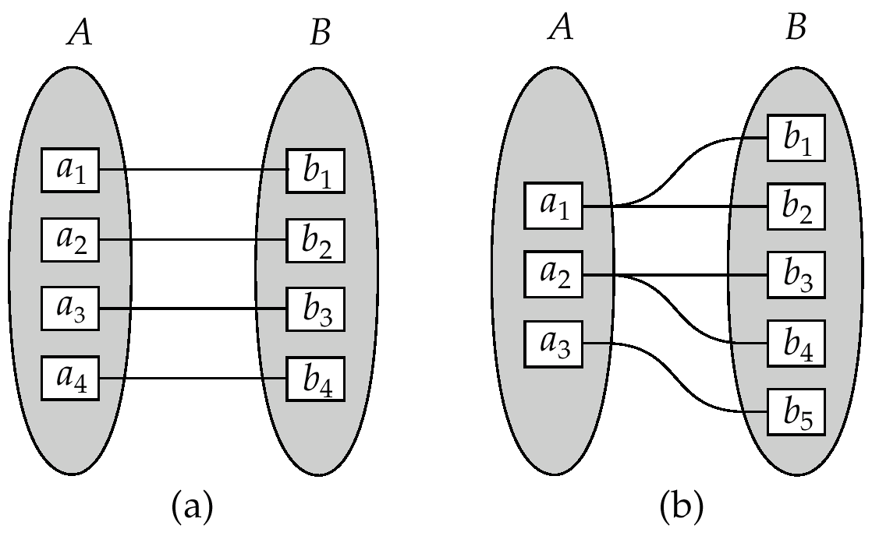
Mapping Cardinalities
One to one
One to many
Note: Some elements in A and B may not be mapped to any
elements in the other set

Slide 12
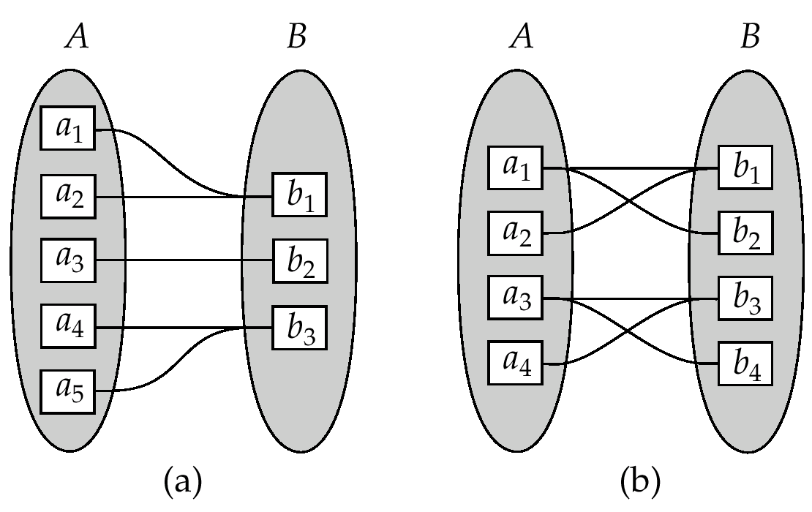
Mapping Cardinalities
Many to one
Many to many
Note: Some elements in A and B may not be mapped to any
elements in the other set

Slide 13
II. Key Constraints
Keys are very important part of Relational database.
They are used to establish and identify relation between tables.
They also ensure that each record within a table can be uniquely identified by combination of one or more fields within a table.

Slide 14
Key Constraints
Types of keys in DBMS
Primary Key
Super Key
Candidate Key
Foreign Key

Slide 15
Key Constraints Primary Key
Primary Key – A primary is a column or set of columns in a table that uniquely identifies tuples (rows) in that table.
Student Table
Stu_Id | Stu_Name | Stu_Age
101 | Steve | 23
102 | John | 24
103 | Robert | 28
104 | Carl | 22
In the above Student table, the Stu_Id column uniquely identifies each row of the table.

Slide 16
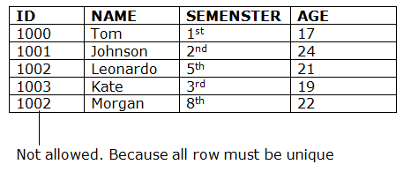
Key Constraints Primary Key
Primary Key
The value of primary key should be unique for each row of the table. Primary key column cannot contain duplicate values.
Primary key column should not contain nulls.

Slide 17
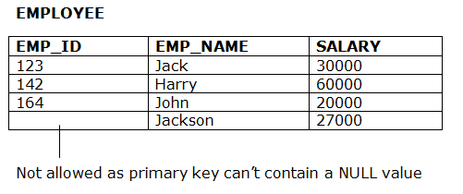
Key Constraints Primary Key
Primary Key
The value of primary key should be unique for each row of the table. Primary key column cannot contain duplicate values.
Primary key column should not contain nulls.

Slide 18
Super Key & Candidate Key
Super Key – A super key is a set of one of more columns (attributes) to uniquely identify rows in a table.
Candidate Key – A super key with no redundant attribute is known as candidate key
For example:
Emp_SSN | Emp_Number | Emp_Name
123456789 | 226 | Steve
999999321 | 227 | Ajeet
888997212 | 228 | Chaitanya
777778888 | 229 | Robert

Slide 19
Super Key & Candidate Key
Emp_SSN | Emp_Number | Emp_Name
123456789 | 226 | Steve
999999321 | 227 | Ajeet
888997212 | 228 | Chaitanya
777778888 | 229 | Robert
Super keys:
{Emp_SSN}
{Emp_Number}
{Emp_SSN, Emp_Number}
{Emp_SSN, Emp_Name}
{Emp_SSN, Emp_Number, Emp_Name}
{Emp_Number, Emp_Name}
All of the above sets are able to uniquely identify rows of the employee table.

Slide 20
Candidate Key
{Emp_SSN}
{Emp_Number}
Only these two sets are candidate keys as all other sets are having redundant attributes that are not necessary for unique identification.
Primary key is being selected from the sets of candidate keys by database designer.
So Either {Emp_SSN} or {Emp_Number} can be the primary key.

Slide 21
Foreign Key
Foreign keys are the columns of a table that points to the primary key of another table.
They act as a cross-reference between tables.
Course_enrollment table:
Course_Id | Stu_Id
C01 | 101
C02 | 102
C03 | 101
C05 | 102
C06 | 103
C07 | 102
Student table:
Stu_Id | Stu_Name | Stu_Age
101 | Chaitanya | 22
102 | Arya | 26
103 | Bran | 25
104 | Jon | 21

Slide 22
Foreign Key
In the below example the Stu_Id column in Course_enrollment table is a foreign key as it points to the primary key of the Student table.
Course_enrollment table:
Course_Id | Stu_Id
C01 | 101
C02 | 102
C03 | 101
C05 | 102
C06 | 103
C07 | 102
Student table:
Stu_Id | Stu_Name | Stu_Age
101 | Chaitanya | 22
102 | Arya | 26
103 | Bran | 25
104 | Jon | 21

Slide 23
Primary Key & Super Key Difference
If you add any other column/attribute to a Primary Key then it become a super key, like EmployeeID + FullName is a Super Key.

Slide 24
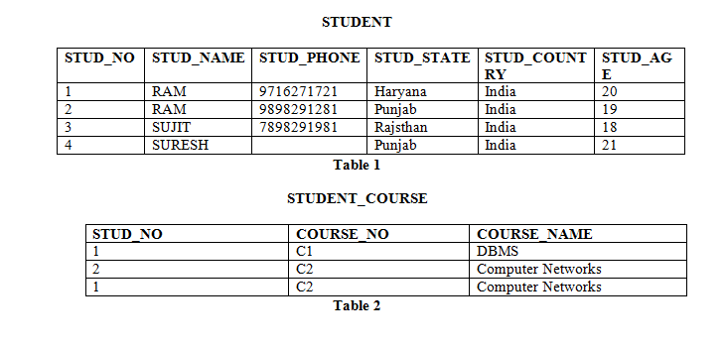
Further Examples…..

Slide 25
Candidate Key - Example
Candidate Key: The minimal set of attribute which can uniquely identify a tuple is known as candidate key. For Example, STUD_NO in STUDENT relation.
The value of Candidate Key is unique and non-null for every tuple.
There can be more than one candidate key in a relation. For Example, STUD_NO as well as STUD_PHONE both are candidate keys for relation STUDENT.
The candidate key can be simple (having only one attribute) or composite as well. For Example, {STUD_NO, COURSE_NO} is a composite candidate key for relation STUDENT_COURSE.

Slide 26
Super Key - Example
Super Key: The set of attributes which can uniquely identify a tuple is known as Super Key. For Example, STUD_NO, (STUD_NO, STUD_NAME) etc.
Adding zero or more attributes to candidate key generates super key.
A candidate key is a super key but vice versa is not true.

Slide 27
Primary Key - Example
There can be more than one candidate key in a relation out of which one can be chosen as primary key.
For Example, STUD_NO as well as STUD_PHONE both are candidate keys for relation STUDENT but STUD_NO can be chosen as primary key (only one out of many candidate keys).

Slide 28
III. Domain integrity constraints & Referential Integrity constraints
Domain constraints
Domain constraints can be defined as the definition of a valid set of values for an attribute.
The data type of domain includes string, character, integer, time, date, currency, etc. The value of the attribute must be available in the corresponding domain.
ID | NAME | SEMESTER | AGE
101 | RAJA | 4 | 19
102 | SHEELA | 2 | 18
103 | JOHN | 3 | A

Slide 29
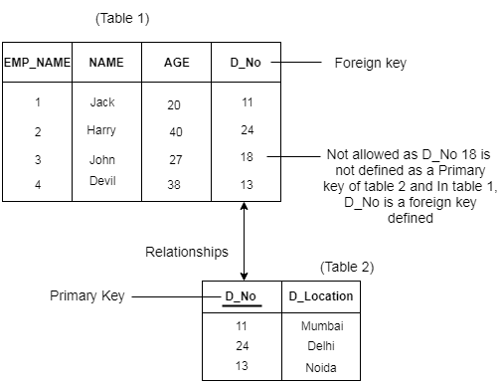
III. Domain integrity constraints & Referential Integrity constraints
Referential Integrity Constraints
A referential integrity constraint is specified between two tables.
In the Referential integrity constraints, if a foreign key in Table 1 refers to the Primary Key of Table 2, then every value of the Foreign Key in Table 1 must be available in Table 2.

Slide 30
IV . Participation Constraints
A participation constraint defines the number of times an object in an object class can participate in a connected relationship set. Every connection of a relationship set must have a participation constraint. However, participation constraints do not apply to relationships.
The basic form for a participation constraint is min:max, where min is a non negative integer, and max is either a non negative integer or a star (*). The star designates an arbitrary non negative number greater than min. The most common participation constraints are 0:1, 1:1, 0:*, and 1:*.

Slide 31
IV . Participation Constraints
There are two kinds of participation constraints.
Total Participation (Existence dependency) :
Partial Dependency

Slide 32
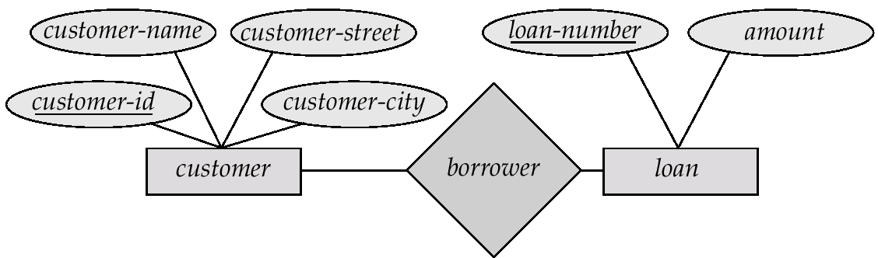
E-R Diagrams
Rectangles represent entity sets.
Diamonds represent relationship sets.
Lines link attributes to entity sets and entity sets to relationship sets.
Ellipses represent attributes
Double ellipses represent multivalued attributes.
Dashed ellipses denote derived attributes.
Underline indicates primary key attributes (will study later)

Slide 33
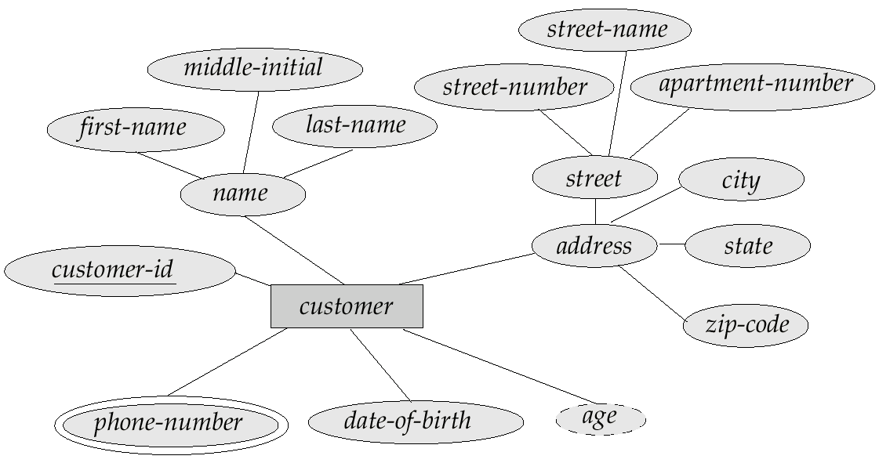
E-R Diagram With Composite, Multivalued, and Derived Attributes

Slide 34
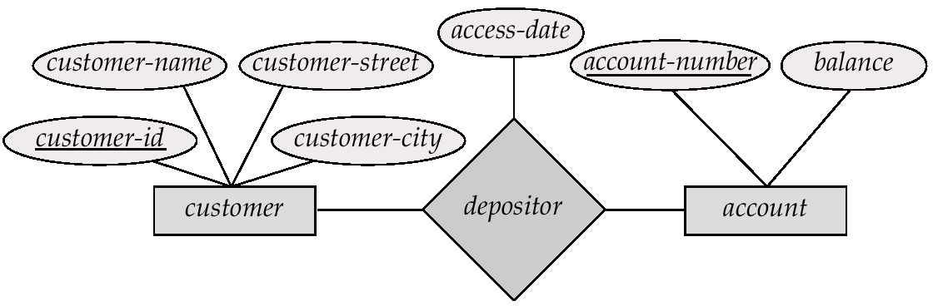
Relationship Sets with Attributes

Slide 35
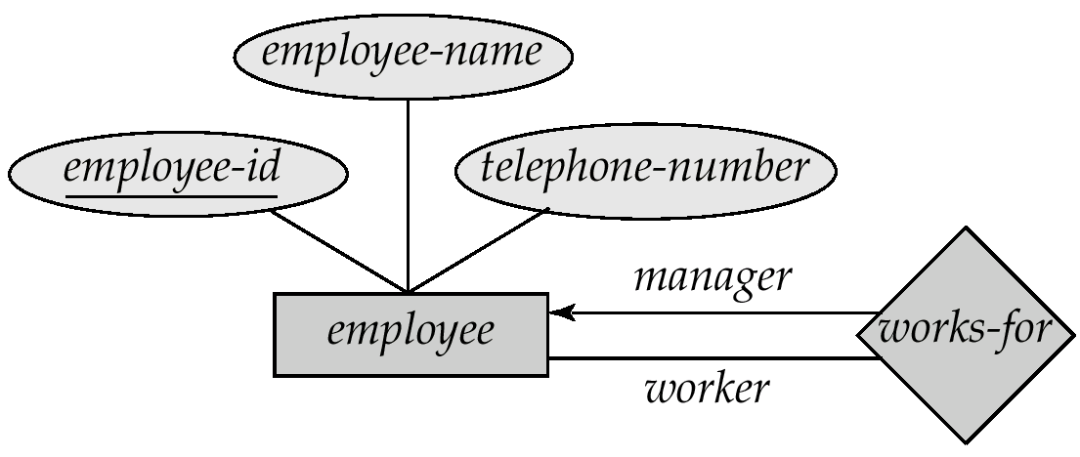
Roles
Entity sets of a relationship need not be distinct
The labels “manager” and “worker” are called roles; they specify how employee entities interact via the works-for relationship set.
Roles are indicated in E-R diagrams by labeling the lines that connect diamonds to rectangles.
Role labels are optional, and are used to clarify semantics of the relationship

Slide 36
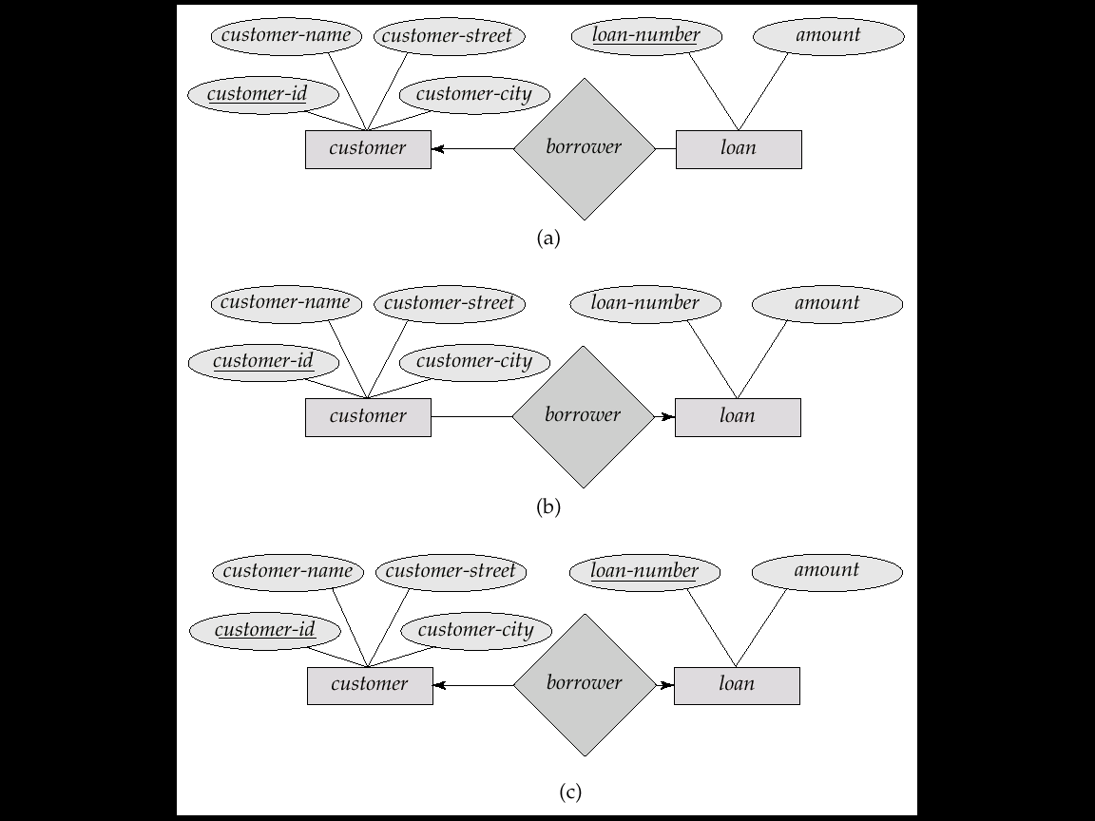
Cardinality Constraints
We express cardinality constraints by drawing either a directed line (→), signifying “one,” or an undirected line (—), signifying “many,” between the relationship set and the entity set.
E.g.: One-to-one relationship:
A customer is associated with at most one loan via the relationship borrower
A loan is associated with at most one customer via borrower

Slide 37
One-To-Many Relationship
In the one-to-many relationship a loan is associated with at most one customer via borrower, a customer is associated with several (including 0) loans via borrower

Slide 38
Many-To-One Relationships
In a many-to-one relationship a loan is associated with several (including 0) customers via borrower, a customer is associated with at most one loan via borrower

Slide 39
Many-To-Many Relationship
A customer is associated with several (possibly 0) loans via borrower
A loan is associated with several (possibly 0) customers via borrower

Slide 40
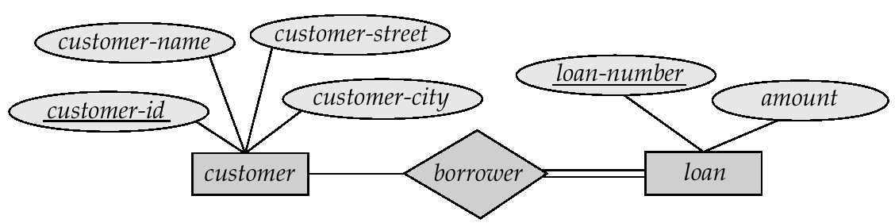
Participation of an Entity Set in a Relationship Set
Total participation (indicated by double line): every entity in the entity set participates in at least one relationship in the relationship set
E.g. participation of loan in borrower is total
every loan must have a customer associated to it via borrower
Partial participation: some entities may not participate in any relationship in the relationship set
E.g. participation of customer in borrower is partial

Slide 41
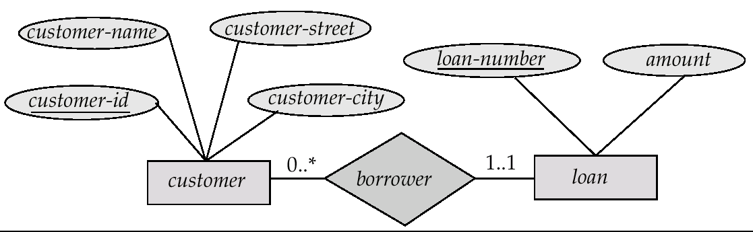
Alternative Notation for Cardinality Limits
Cardinality limits can also express participation constraints

Slide 42
Keys
A super key of an entity set is a set of one or more attributes whose values uniquely determine each entity.
A candidate key of an entity set is a minimal super key
Customer-id is candidate key of customer
account-number is candidate key of account
Although several candidate keys may exist, one of the candidate keys is selected to be the primary key.

Slide 43
Keys for Relationship Sets
The combination of primary keys of the participating entity sets forms a super key of a relationship set.
(customer-id, account-number) is the super key of depositor
NOTE: this means a pair of entity sets can have at most one relationship in a particular relationship set.
E.g. if we wish to track all access-dates to each account by each customer, we cannot assume a relationship for each access. We can use a multivalued attribute though
Must consider the mapping cardinality of the relationship set when deciding the what are the candidate keys
Need to consider semantics of relationship set in selecting the primary key in case of more than one candidate key

Slide 44
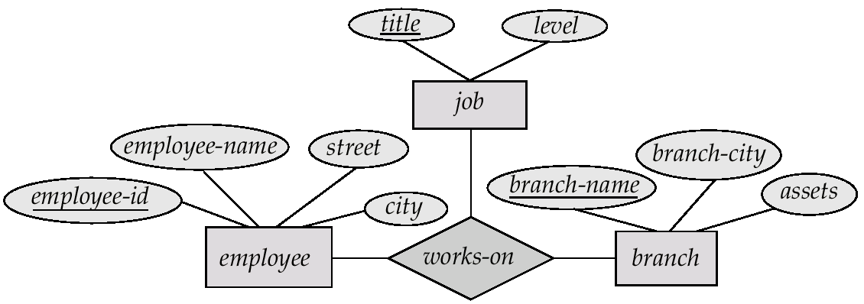
E-R Diagram with a Ternary Relationship

Slide 45
Design Issues
Use of entity sets vs. attributes Choice mainly depends on the structure of the enterprise being modeled, and on the semantics associated with the attribute in question.
Use of entity sets vs. relationship sets Possible guideline is to designate a relationship set to describe an action that occurs between entities
Binary versus n-ary relationship sets Although it is possible to replace any nonbinary (n-ary, for n > 2) relationship set by a number of distinct binary relationship sets, a n-ary relationship set shows more clearly that several entities participate in a single relationship.
Placing Relationship Attributes
The cardinality ratios can become an affective measure in the placement of the relationship attributes. So, it is better to associate the attributes of one-to-one or one-to-many relationship sets with any participating entity sets, instead of any relationship set.

Slide 46
How about doing an ER design interactively on the board? Suggest an application to be modeled.

Slide 47
Weak Entity Sets
An entity set that does not have a primary key is referred to as a weak entity set.
The existence of a weak entity set depends on the existence of a identifying entity set
it must relate to the identifying entity set via a total, one-to-many relationship set from the identifying to the weak entity set
Identifying relationship depicted using a double diamond
The discriminator (or partial key) of a weak entity set is the set of attributes that distinguishes among all the entities of a weak entity set.
The primary key of a weak entity set is formed by the primary key of the strong entity set on which the weak entity set is existence dependent, plus the weak entity set’s discriminator.

Slide 48
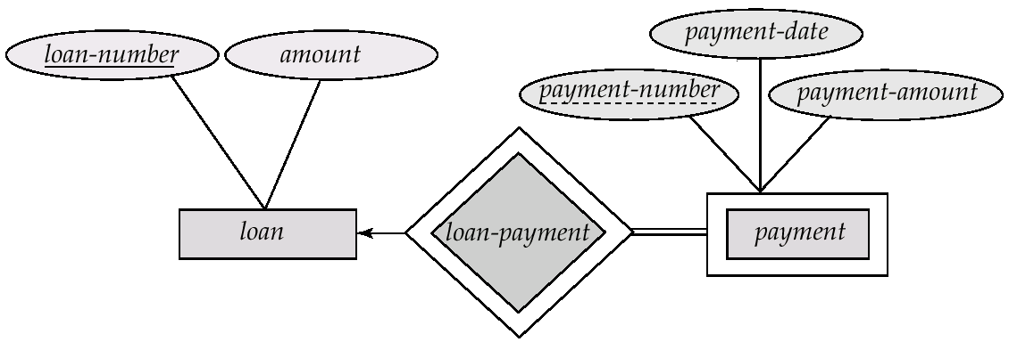
Weak Entity Sets (Cont.)
We depict a weak entity set by double rectangles.
We underline the discriminator of a weak entity set with a dashed line.
payment-number – discriminator of the payment entity set
Primary key for payment – (loan-number, payment-number)

Slide 49
Weak Entity Sets (Cont.)
Note: the primary key of the strong entity set is not explicitly stored with the weak entity set, since it is implicit in the identifying relationship.
If loan-number were explicitly stored, payment could be made a strong entity, but then the relationship between payment and loan would be duplicated by an implicit relationship defined by the attribute loan-number common to payment and loan

Slide 50
More Weak Entity Set Examples
In a university, a course is a strong entity and a course-offering can be modeled as a weak entity
The discriminator of course-offering would be semester (including year) and section-number (if there is more than one section)
If we model course-offering as a strong entity we would model course-number as an attribute.
Then the relationship with course would be implicit in the course-number attribute

Slide 51
Specialization
Top-down design process; we designate subgroupings within an entity set that are distinctive from other entities in the set.
These subgroupings become lower-level entity sets that have attributes or participate in relationships that do not apply to the higher-level entity set.
Depicted by a triangle component labeled ISA (E.g. customer “is a” person).
Attribute inheritance – a lower-level entity set inherits all the attributes and relationship participation of the higher-level entity set to which it is linked.

Slide 52
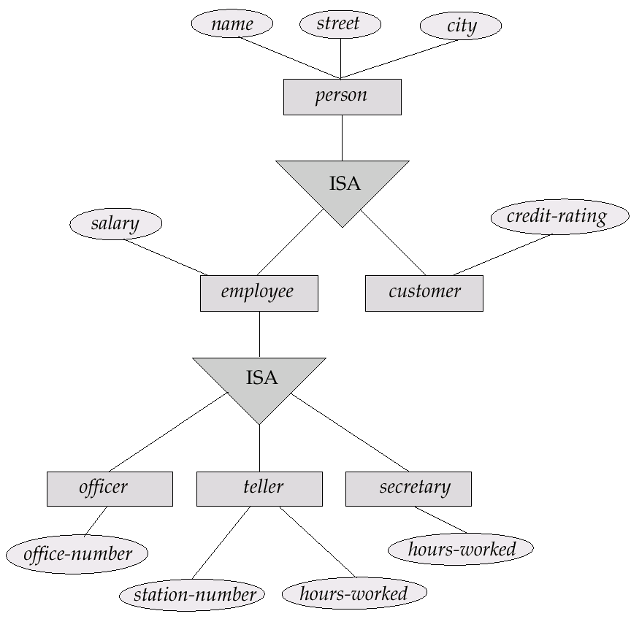
Specialization Example

Slide 53
Generalization
A bottom-up design process – combine a number of entity sets that share the same features into a higher-level entity set.
Specialization and generalization are simple inversions of each other; they are represented in an E-R diagram in the same way.
The terms specialization and generalization are used interchangeably.

Slide 54
Specialization and Generalization (Contd.)
Can have multiple specializations of an entity set based on different features.
E.g. permanent-employee vs. temporary-employee, in addition to officer vs. secretary vs. teller
Each particular employee would be
a member of one of permanent-employee or temporary-employee,
and also a member of one of officer, secretary, or teller
The ISA relationship also referred to as superclass - subclass relationship

Slide 55
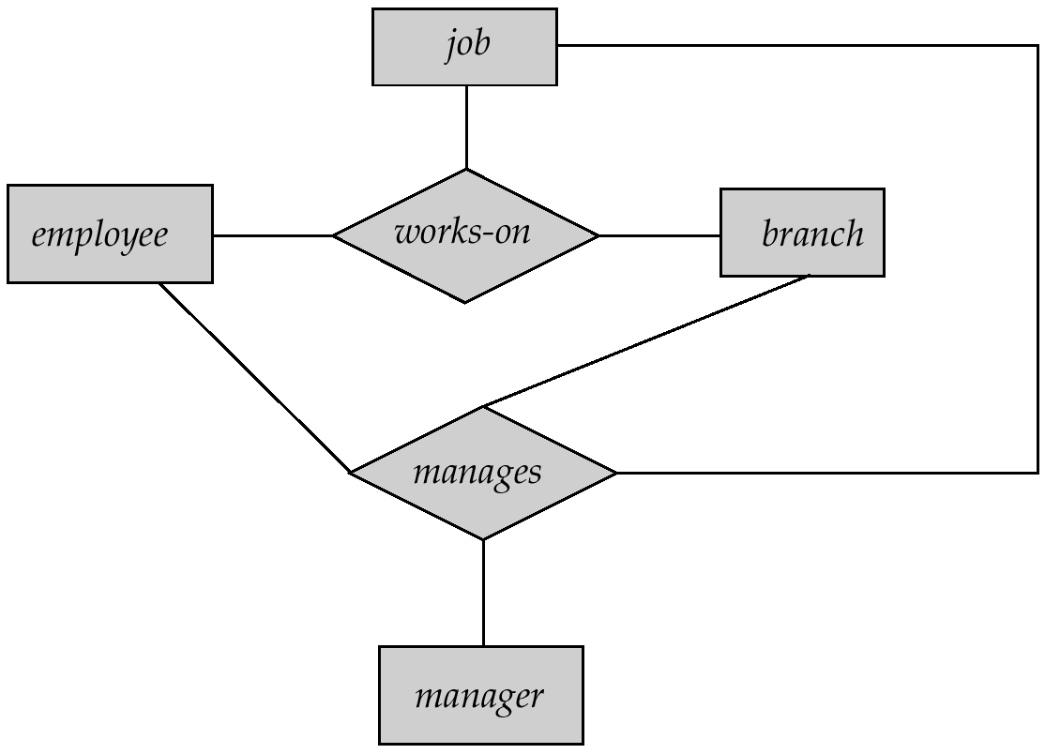
Aggregation
Consider the ternary relationship works-on, which we saw earlier
Suppose we want to record managers for tasks performed by an employee at a branch

Slide 56
Aggregation (Cont.)
Relationship sets works-on and manages represent overlapping information
Every manages relationship corresponds to a works-on relationship
However, some works-on relationships may not correspond to any manages relationships
So we can’t discard the works-on relationship
Eliminate this redundancy via aggregation
Treat relationship as an abstract entity
Allows relationships between relationships
Abstraction of relationship into new entity
Without introducing redundancy, the following diagram represents:
An employee works on a particular job at a particular branch
An employee, branch, job combination may have an associated manager

Slide 57
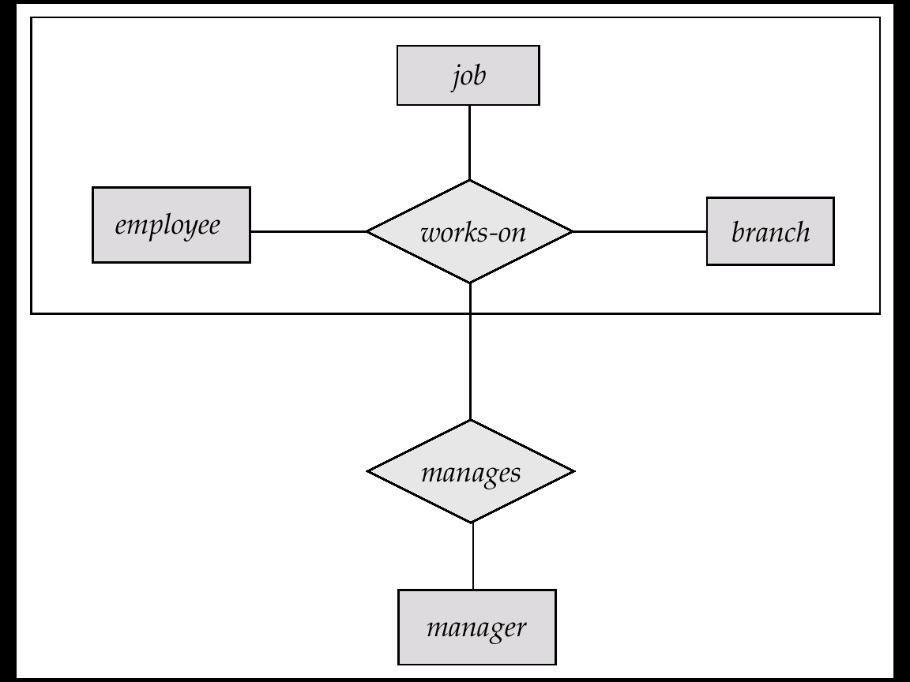
E-R Diagram With Aggregation

Slide 58
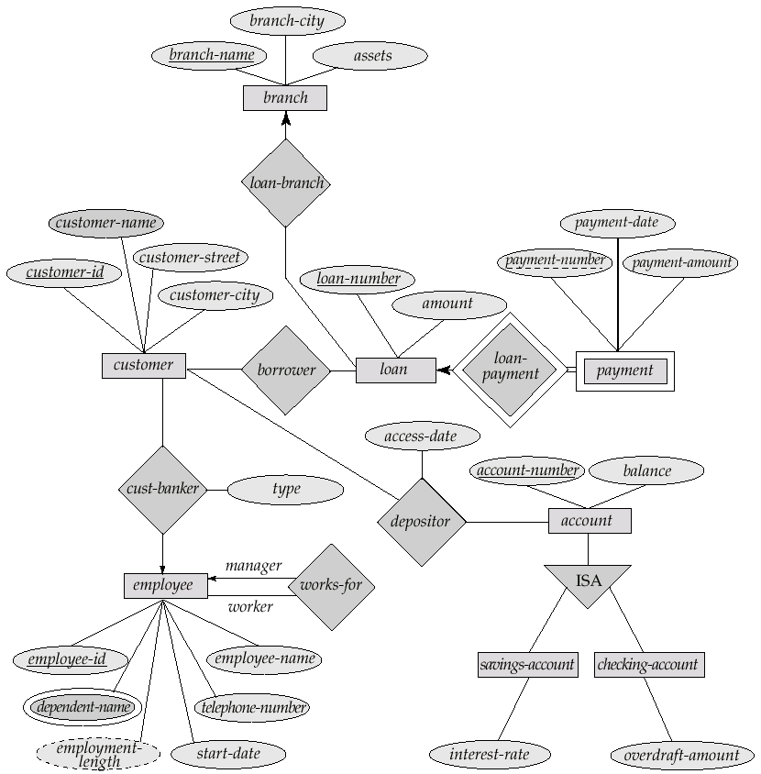
E-R Diagram for a Banking Enterprise

Slide 59
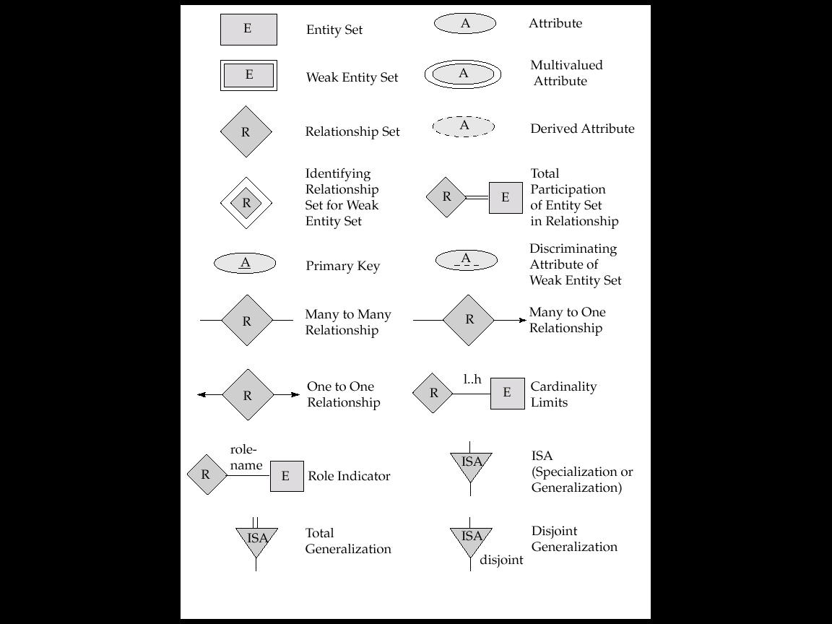
Summary of Symbols Used in E-R Notation

Slide 60
Summary of Symbols (Cont.)

Slide 61
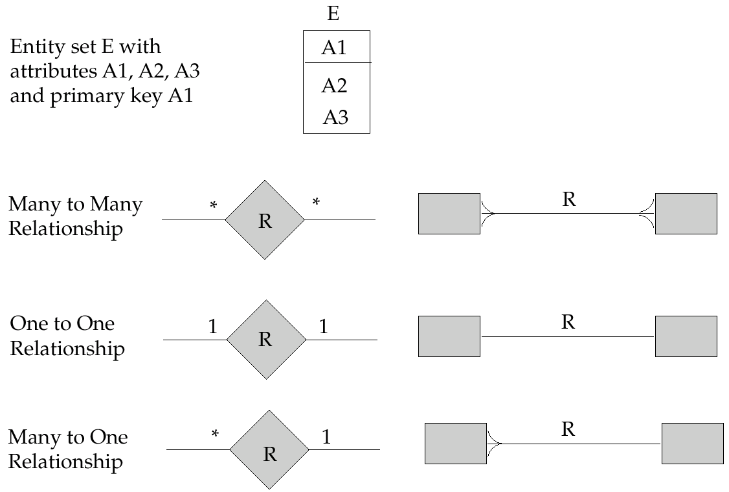
Alternative E-R Notations

Slide 62
UML
UML: Unified Modeling Language
UML has many components to graphically model different aspects of an entire software system
UML Class Diagrams correspond to E-R Diagram, but several differences.

Slide 63
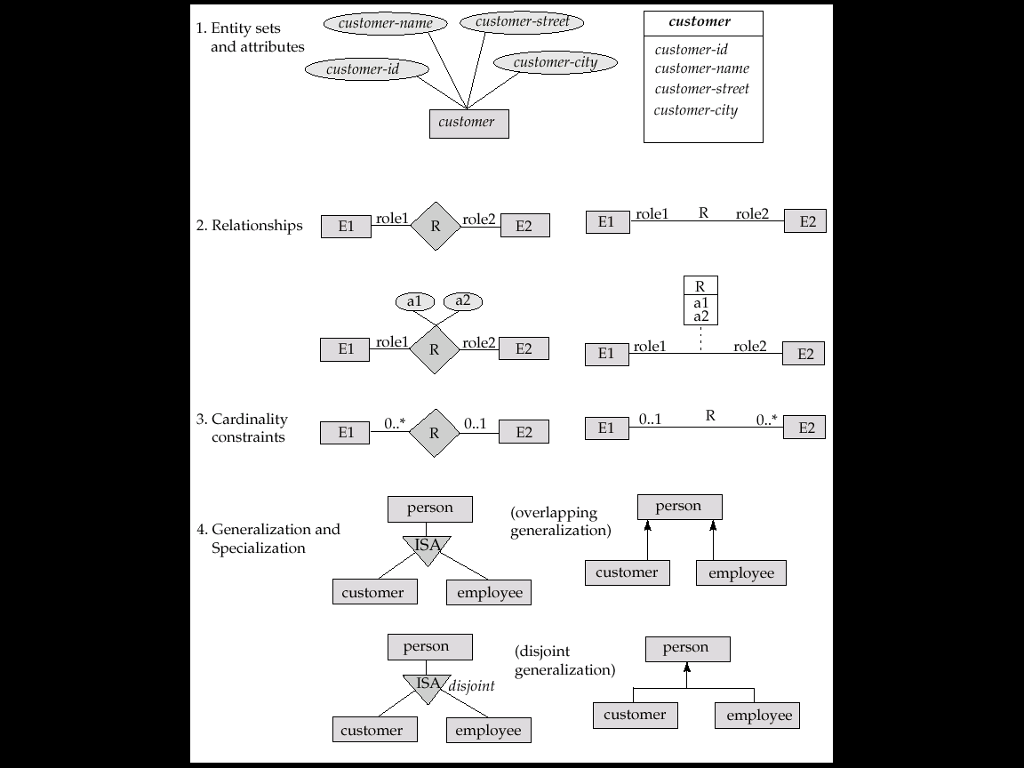
Summary of UML Class Diagram Notation

Slide 64
UML Class Diagrams (Contd.)
Entity sets are shown as boxes, and attributes are shown within the box, rather than as separate ellipses in E-R diagrams.
Binary relationship sets are represented in UML by just drawing a line connecting the entity sets. The relationship set name is written adjacent to the line.
The role played by an entity set in a relationship set may also be specified by writing the role name on the line, adjacent to the entity set.
The relationship set name may alternatively be written in a box, along with attributes of the relationship set, and the box is connected, using a dotted line, to the line depicting the relationship set.
Non-binary relationships drawn using diamonds, just as in ER diagrams

Slide 65
UML Class Diagram Notation (Cont.)
overlapping
disjoint
*Note reversal of position in cardinality constraint depiction
*Generalization can use merged or separate arrows independent
of disjoint/overlapping

Slide 66
UML Class Diagrams (Contd.)
Cardinality constraints are specified in the form l..h, where l denotes the minimum and h the maximum number of relationships an entity can participate in.
Beware: the positioning of the constraints is exactly the reverse of the positioning of constraints in E-R diagrams.
The constraint 0..* on the E2 side and 0..1 on the E1 side means that each E2 entity can participate in at most one relationship, whereas each E1 entity can participate in many relationships; in other words, the relationship is many to one from E2 to E1.
Single values, such as 1 or * may be written on edges; The single value 1 on an edge is treated as equivalent to 1..1, while * is equivalent to 0..*.

Slide 67
Reduction of an E-R Schema to Tables
Primary keys allow entity sets and relationship sets to be expressed uniformly as tables which represent the contents of the database.
A database which conforms to an E-R diagram can be represented by a collection of tables.
For each entity set and relationship set there is a unique table which is assigned the name of the corresponding entity set or relationship set.
Each table has a number of columns (generally corresponding to attributes), which have unique names.
Converting an E-R diagram to a table format is the basis for deriving a relational database design from an E-R diagram.

Slide 68
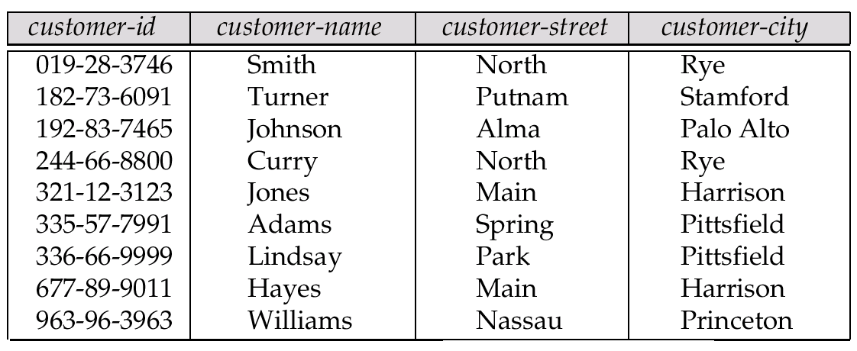
Representing Entity Sets as Tables
A strong entity set reduces to a table with the same attributes.

Slide 69
Composite and Multivalued Attributes
Composite attributes are flattened out by creating a separate attribute for each component attribute
E.g. given entity set customer with composite attribute name with component attributes first-name and last-name the table corresponding to the entity set has two attributes name.first-name and name.last-name
A multivalued attribute M of an entity E is represented by a separate table EM
Table EM has attributes corresponding to the primary key of E and an attribute corresponding to multivalued attribute M
E.g. Multivalued attribute dependent-names of employee is represented by a table employee-dependent-names( employee-id, dname)
Each value of the multivalued attribute maps to a separate row of the table EM
E.g., an employee entity with primary key John and dependents Johnson and Johndotir maps to two rows: (John, Johnson) and (John, Johndotir)

Slide 70
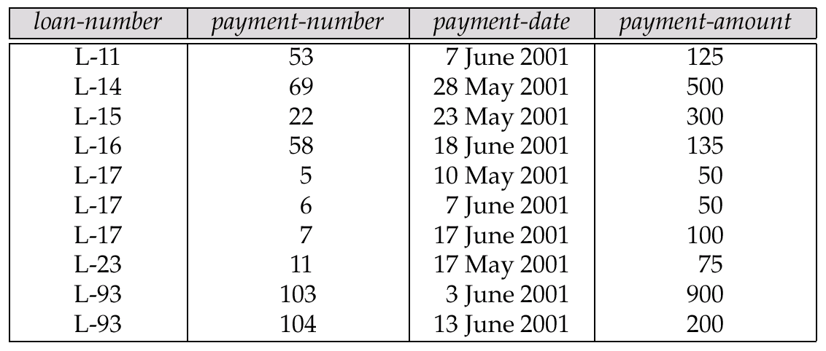
Representing Weak Entity Sets
A weak entity set becomes a table that includes a column for the primary key of the identifying strong entity set

Slide 71
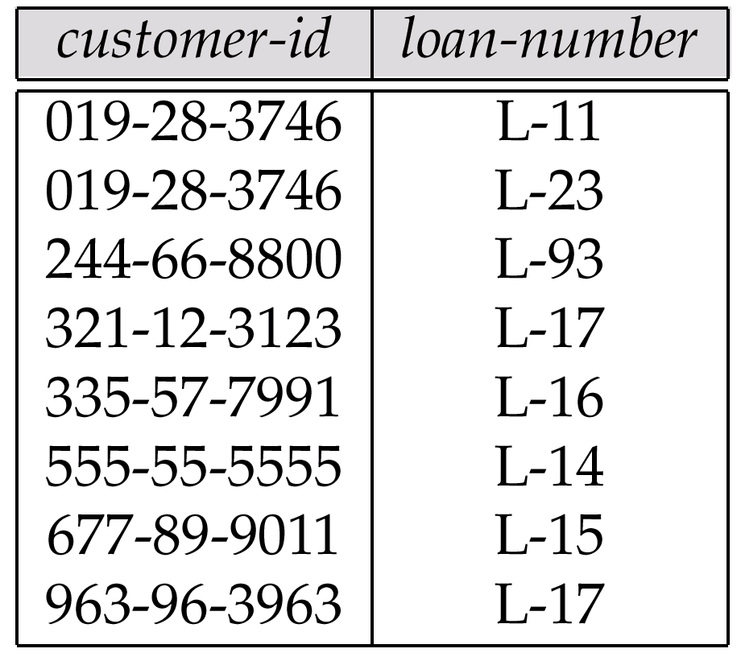
Representing Relationship Sets as Tables
A many-to-many relationship set is represented as a table with columns for the primary keys of the two participating entity sets, and any descriptive attributes of the relationship set.
E.g.: table for relationship set borrower

Slide 72
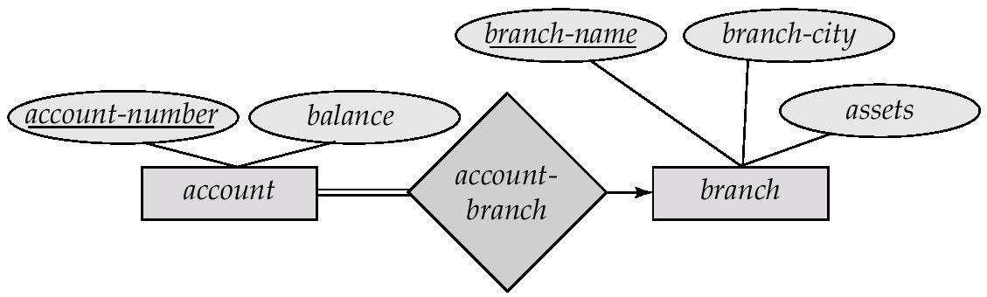
Redundancy of Tables
Many-to-one and one-to-many relationship sets that are total on the many-side can be represented by adding an extra attribute to the many side, containing the primary key of the one side
E.g.: Instead of creating a table for relationship account-branch, add an attribute branch to the entity set account

Slide 73
Redundancy of Tables (Cont.)
For one-to-one relationship sets, either side can be chosen to act as the “many” side
That is, extra attribute can be added to either of the tables corresponding to the two entity sets
If participation is partial on the many side, replacing a table by an extra attribute in the relation corresponding to the “many” side could result in null values
The table corresponding to a relationship set linking a weak entity set to its identifying strong entity set is redundant.
E.g. The payment table already contains the information that would appear in the loan-payment table (i.e., the columns loan-number and payment-number).

Slide 74
Representing Specialization as Tables
Method 1:
Form a table for the higher level entity
Form a table for each lower level entity set, include primary key of higher level entity set and local attributes table table attributes person name, street, city customer name, credit-rating employee name, salary
Drawback: getting information about, e.g., employee requires accessing two tables

Slide 75
Representing Specialization as Tables (Cont.)
Method 2:
Form a table for each entity set with all local and inherited attributes table table attributes person name, street, city customer name, street, city, credit-rating employee name, street, city, salary
If specialization is total, table for generalized entity (person) not required to store information
Can be defined as a “view” relation containing union of specialization tables
But explicit table may still be needed for foreign key constraints
Drawback: street and city may be stored redundantly for persons who are both customers and employees

Slide 76
Relations Corresponding to Aggregation
To represent aggregation, create a table containing
primary key of the aggregated relationship,
the primary key of the associated entity set
Any descriptive attributes

Slide 77
Relations Corresponding to Aggregation (Cont.)
E.g. to represent aggregation manages between relationship works-on and entity set manager, create a table manages(employee-id, branch-name, title, manager-name)
Table works-on is redundant provided we are willing to store null values for attribute manager-name in table manages

Slide 78
End of Chapter 2

Slide 79
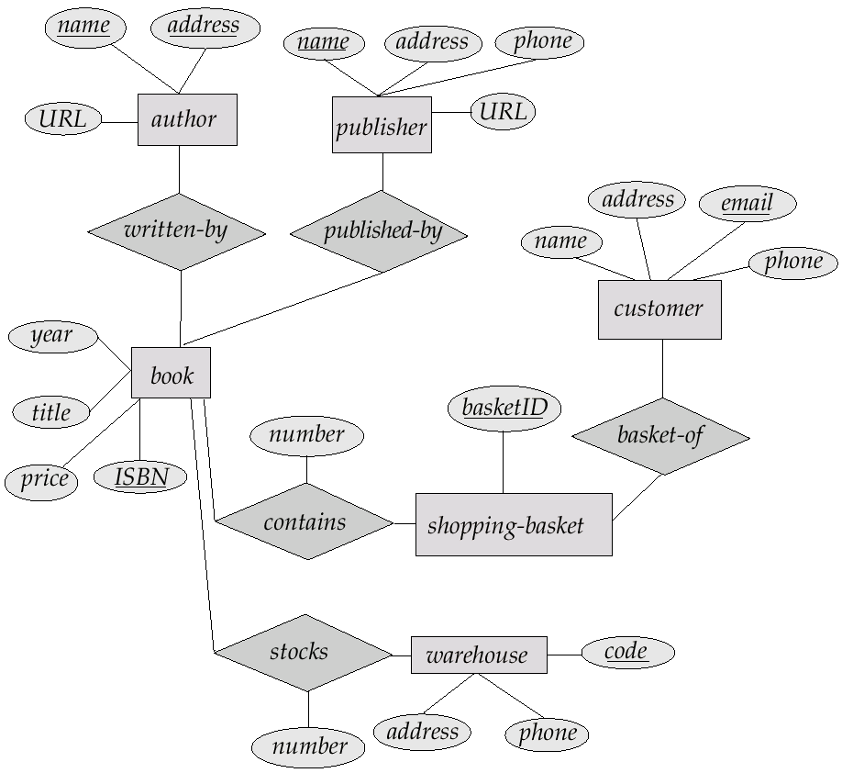
E-R Diagram for Exercise 2.10

Slide 80
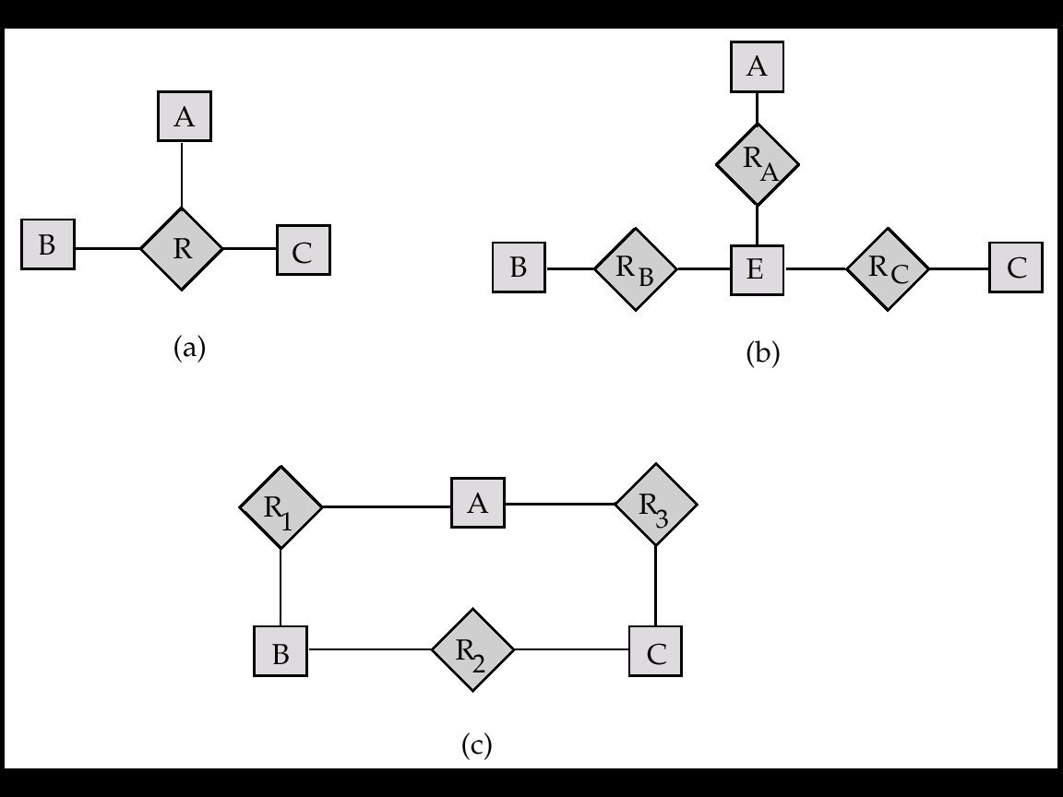
E-R Diagram for Exercise 2.15

Slide 81
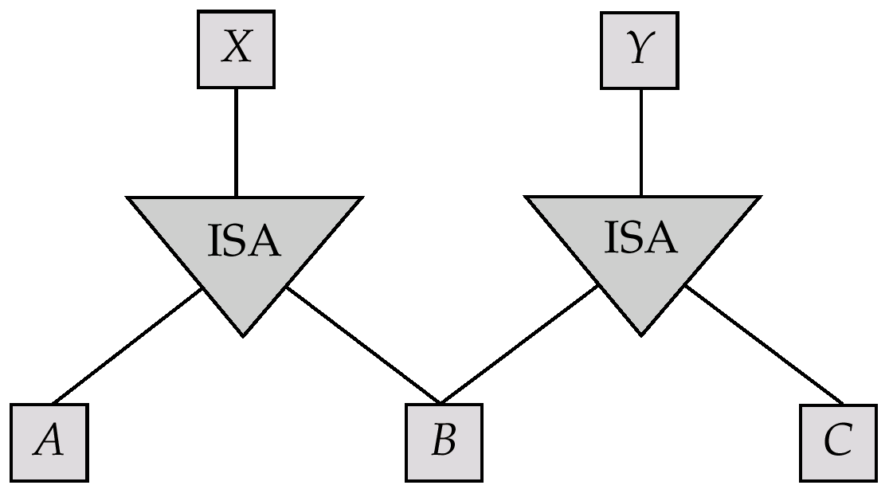
E-R Diagram for Exercise 2.22

Slide 82
E-R Diagram for Exercise 2.15

Slide 83
Existence Dependencies
If the existence of entity x depends on the existence of entity y, then x is said to be existence dependent on y.
y is a dominant entity (in example below, loan)
x is a subordinate entity (in example below, payment)
loan-payment
loan
payment
If a loan entity is deleted, then all its associated payment entities must be deleted also.

